Slide 1
Churn and Retention Analysis
Amirthan Mahindan
Notes:
Welcome to my Churn and Retention Analysis presentation, in which I will investigate reasons as to why customers would possibly leave a telecommunications company.

Slide 2
Demographics
Notes:
The first thing that we will look into when discussing this matter is demographics and how this could affect the rate of people churning.

Slide 3
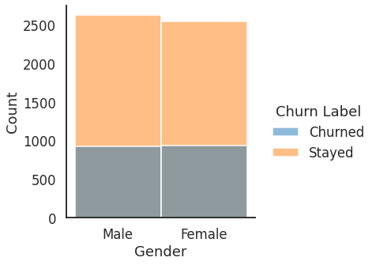
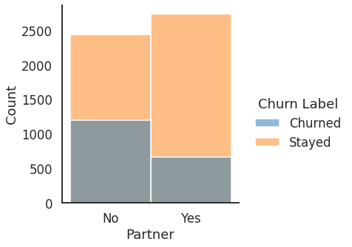
There is no difference in Churning patterns between Male and Female customers.
Customers without a partner are more likely to Churn.
Notes:
To start with, we have a bar graph at the top that shows the total number of male and female customers as well as how many people in each gender have stayed or churned. The graph shows similar churn rates per gender, being 33% for males and 34% for females, indicating that gender does not influence the churn rate.
The bottom graph gives an insight as to whether having a partner or not influences whether a customer may leave. The data suggests that It does, as 46% of customers without a partner churn while 20% of customers churn that do have a partner, which is less than half and therefore indicating that customers that have partners are more beneficial to this company

Slide 4
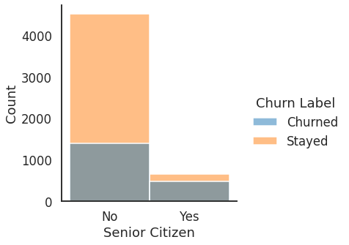
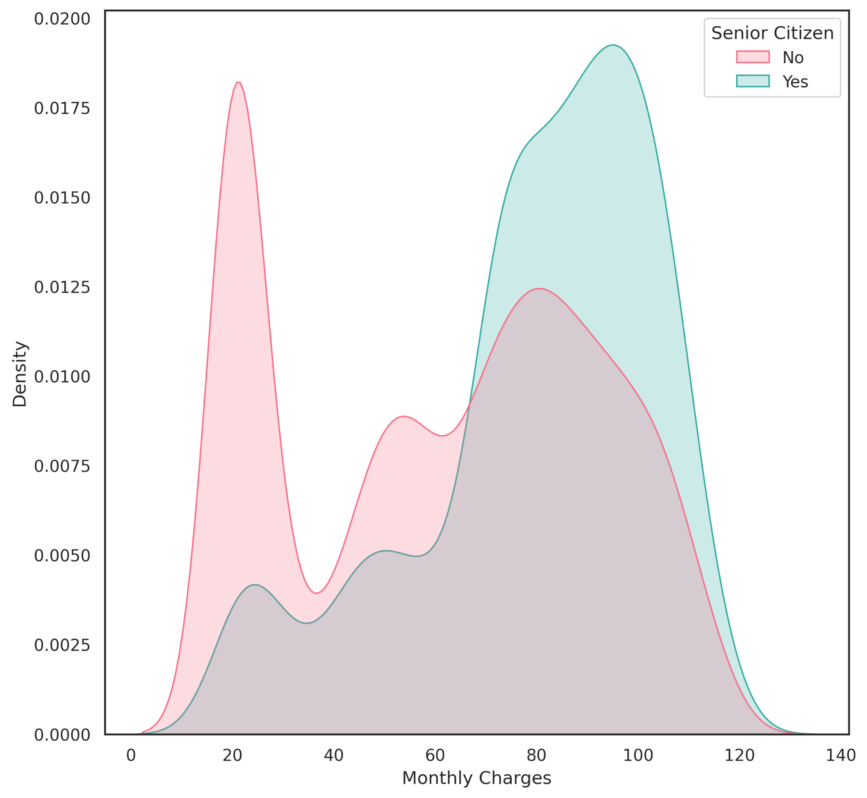
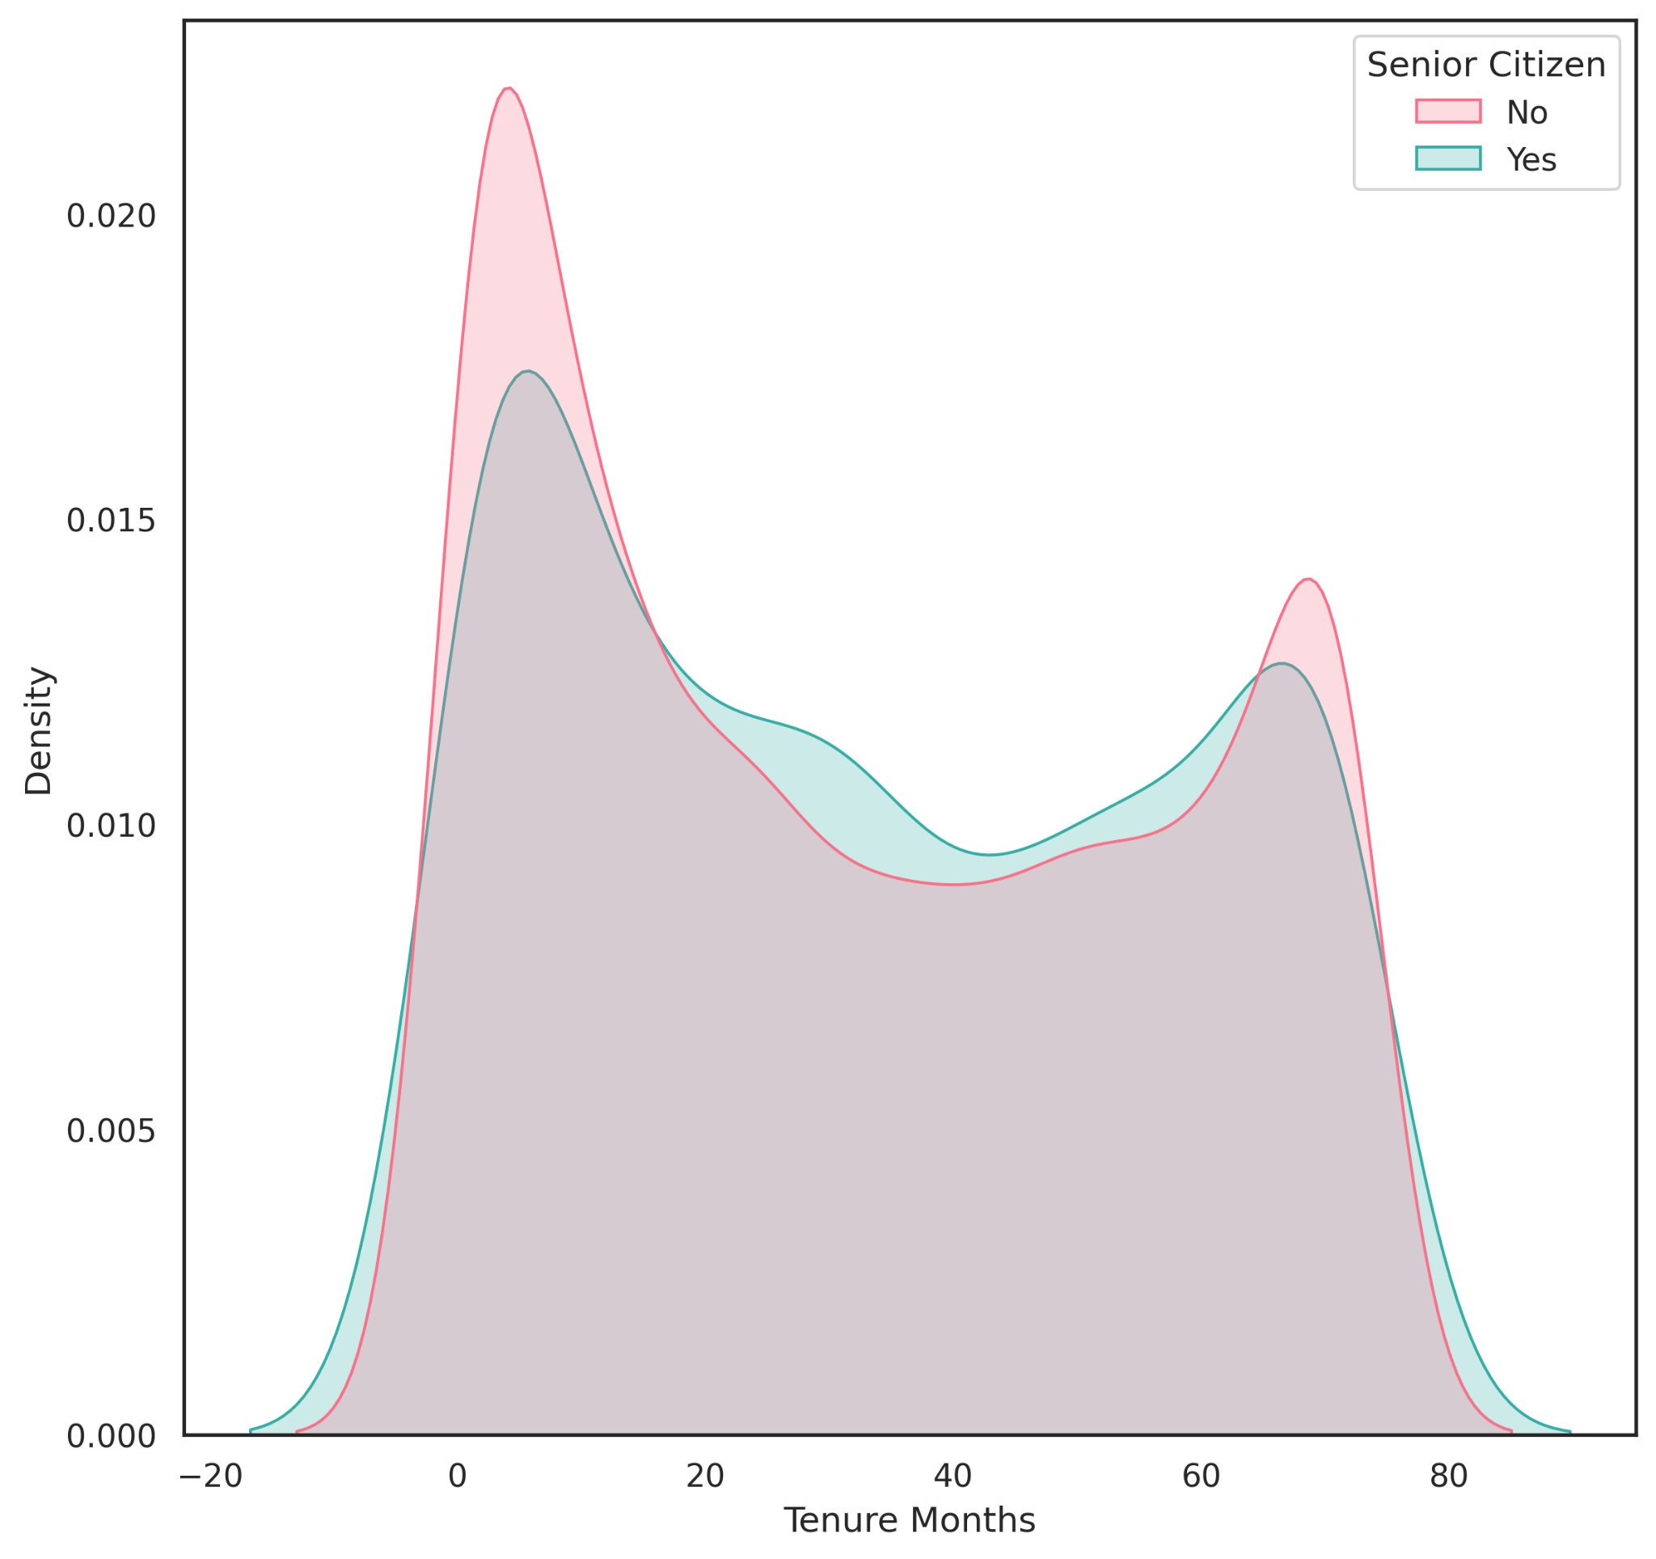
A senior citizen is more likely to churn than a non-senior citizen.
Senior citizens are being charged more for services than younger customers.
Senior citizens are customers at the company for the same period of time but paying more for services.
Notes:
Now let’s look at how elderly customers, who in this case are over 65 years of age, affect churn rates. Elderly customers make up a small proportion of customers, however, of all elderly customers, a higher percentage are more likely to churn. It would therefore be wise for the telecommunications company to focus on younger customers for subscriptions.
Directing your attention to the bottom graph when looking at monthly charges for senior citizens and non-senior citizens, it is clear that senior citizens are being charged more for your services than younger customers, which could be a significant factor in the churn rate.
Additionally, when looking at tenure months for the two groups, there is an even distribution, thus senior citizens are customers at your company for the same period of time, but paying more for services, so it’s expected that more elderly people would leave the company.

Slide 5
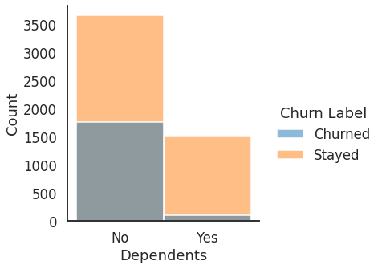
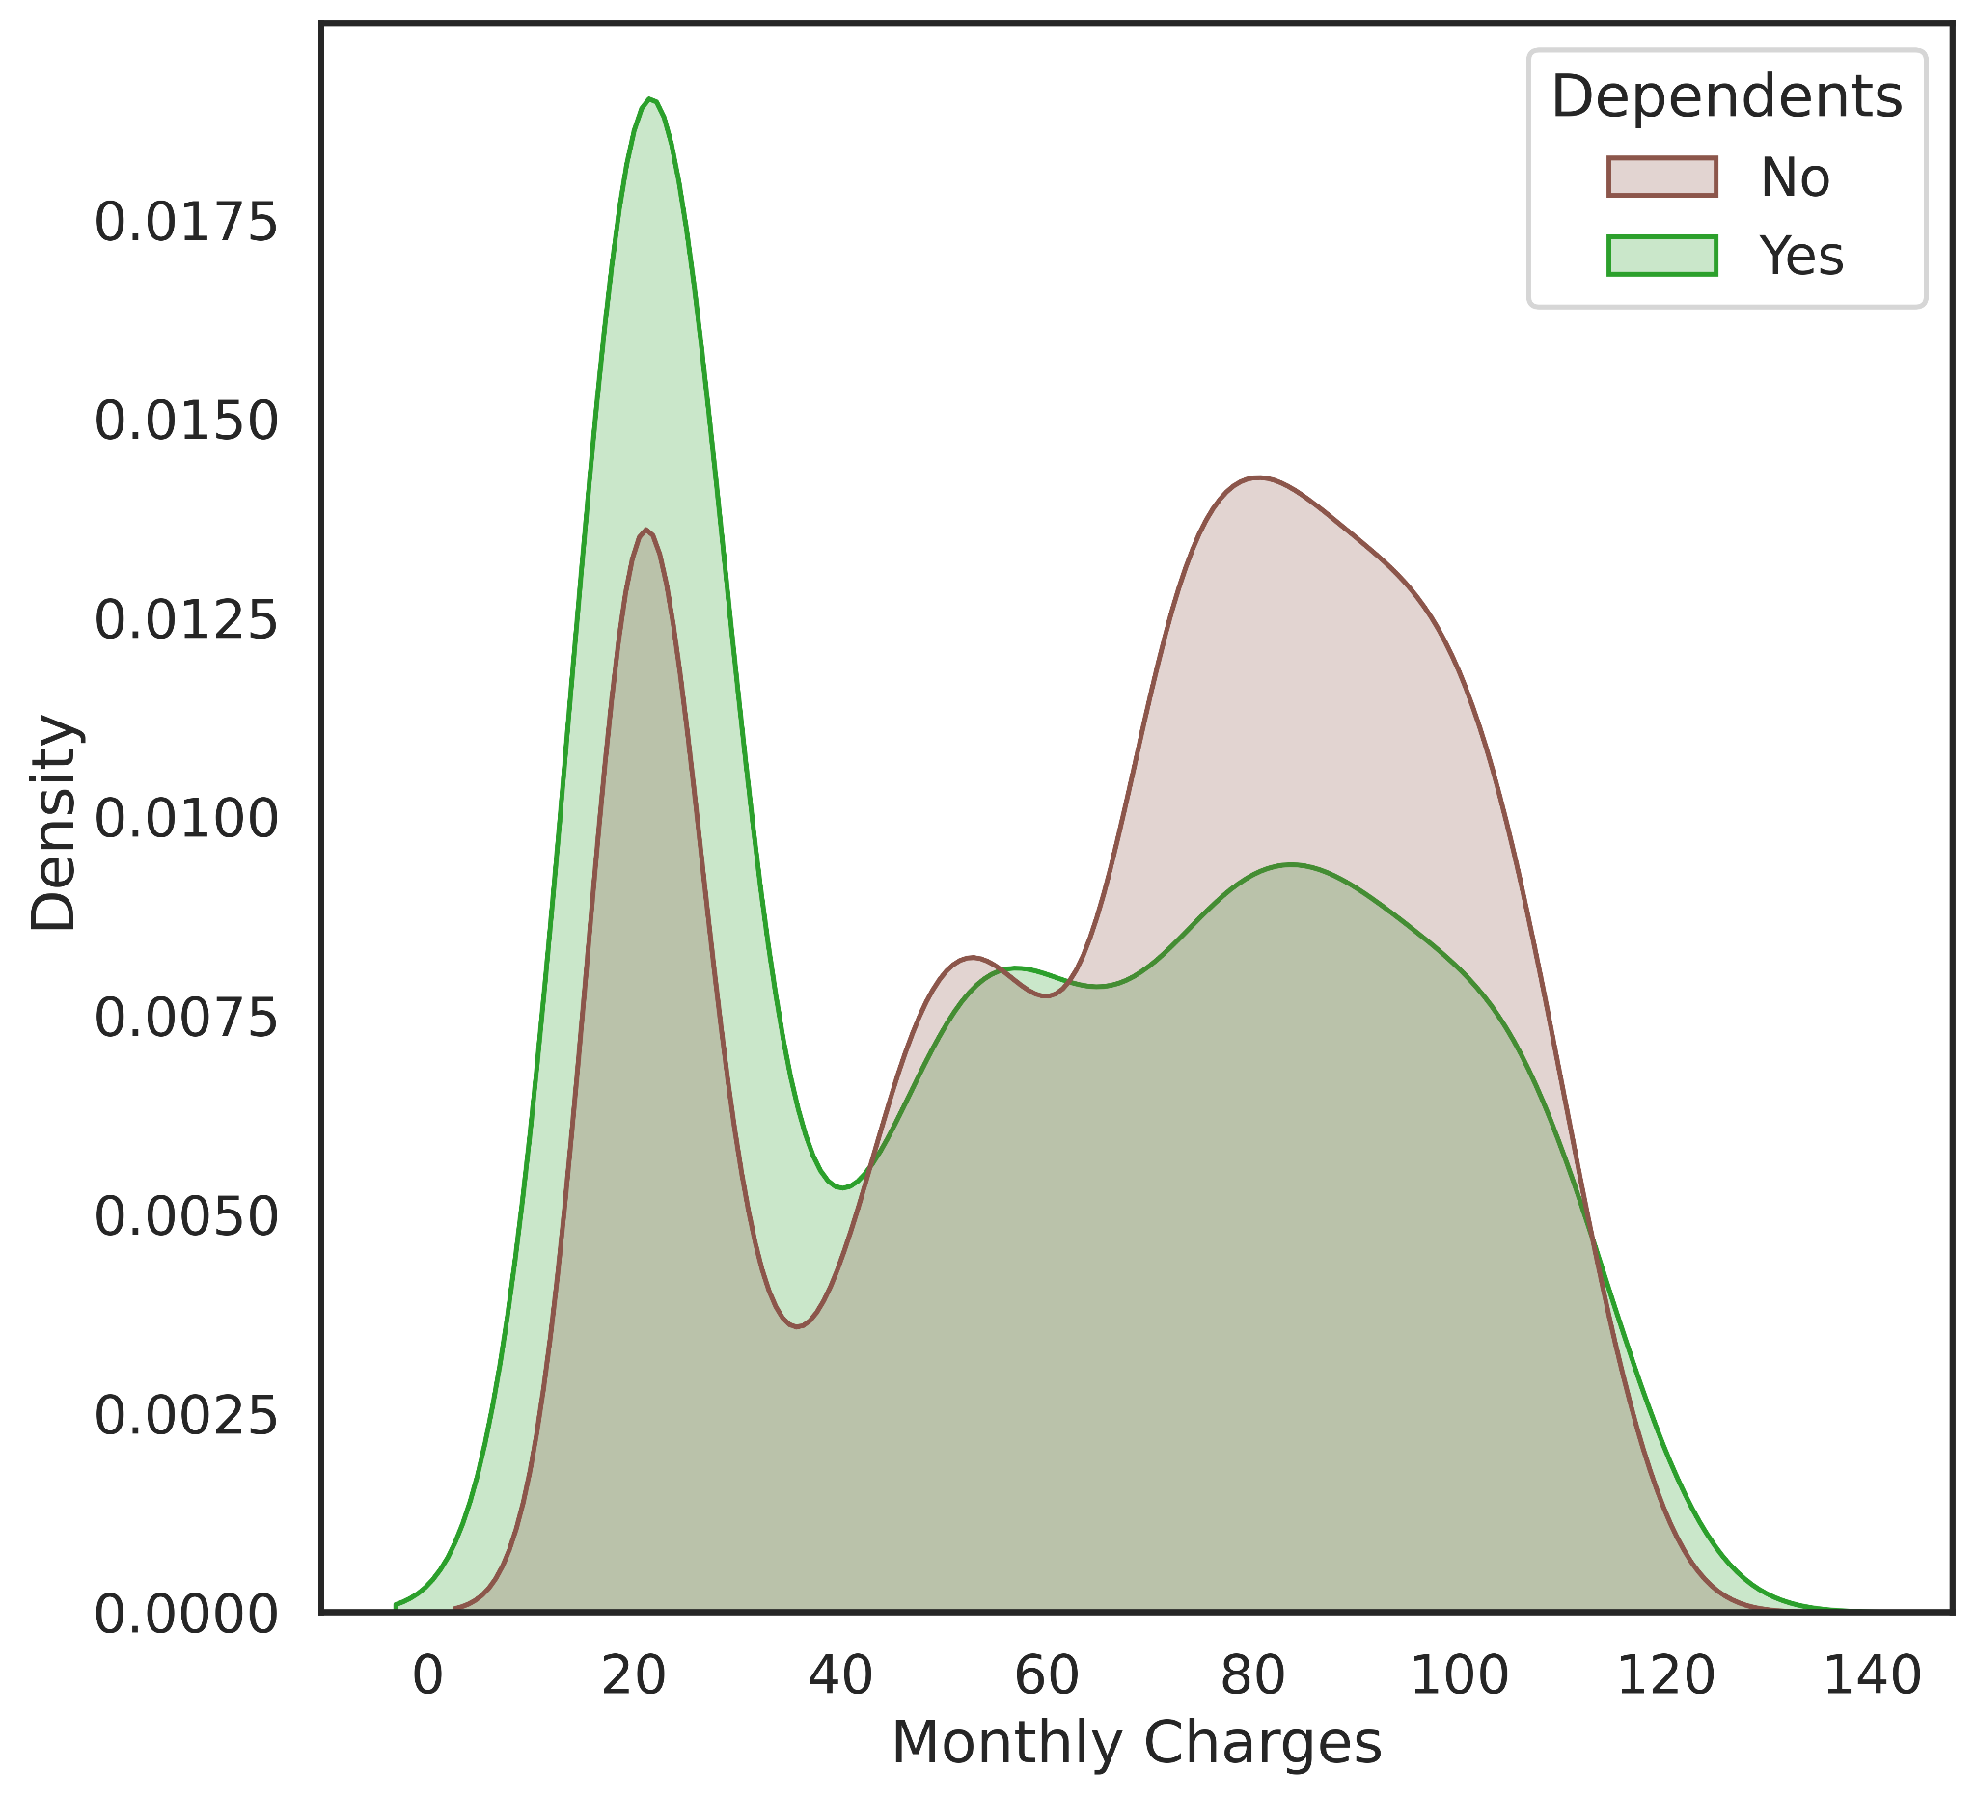
Customers who do not have Dependents are much more likely to Churn.
When we compare the average monthly charges we can see that those who do not have dependents also pay more on average.
Notes:
The first figure shows that customers who do not have Dependents are much more likely to Churn. Even though the number of people with dependents is less than half the number of people without dependents, the rate at which people leave has over a 35% difference.
The graph below shows the distribution of monthly charges. When we compare the average monthly charges we can see that those who do not have dependents also pay more on average. This is partly due to customers who have no dependents using the streaming TV and movie packages more often, which will be explored in more depth later. The company should aim to reduce the cost for those who do not have any dependents.

Slide 6
Churn Factors
Notes:
We will now look into different factors that cause a customer to churn

Slide 7
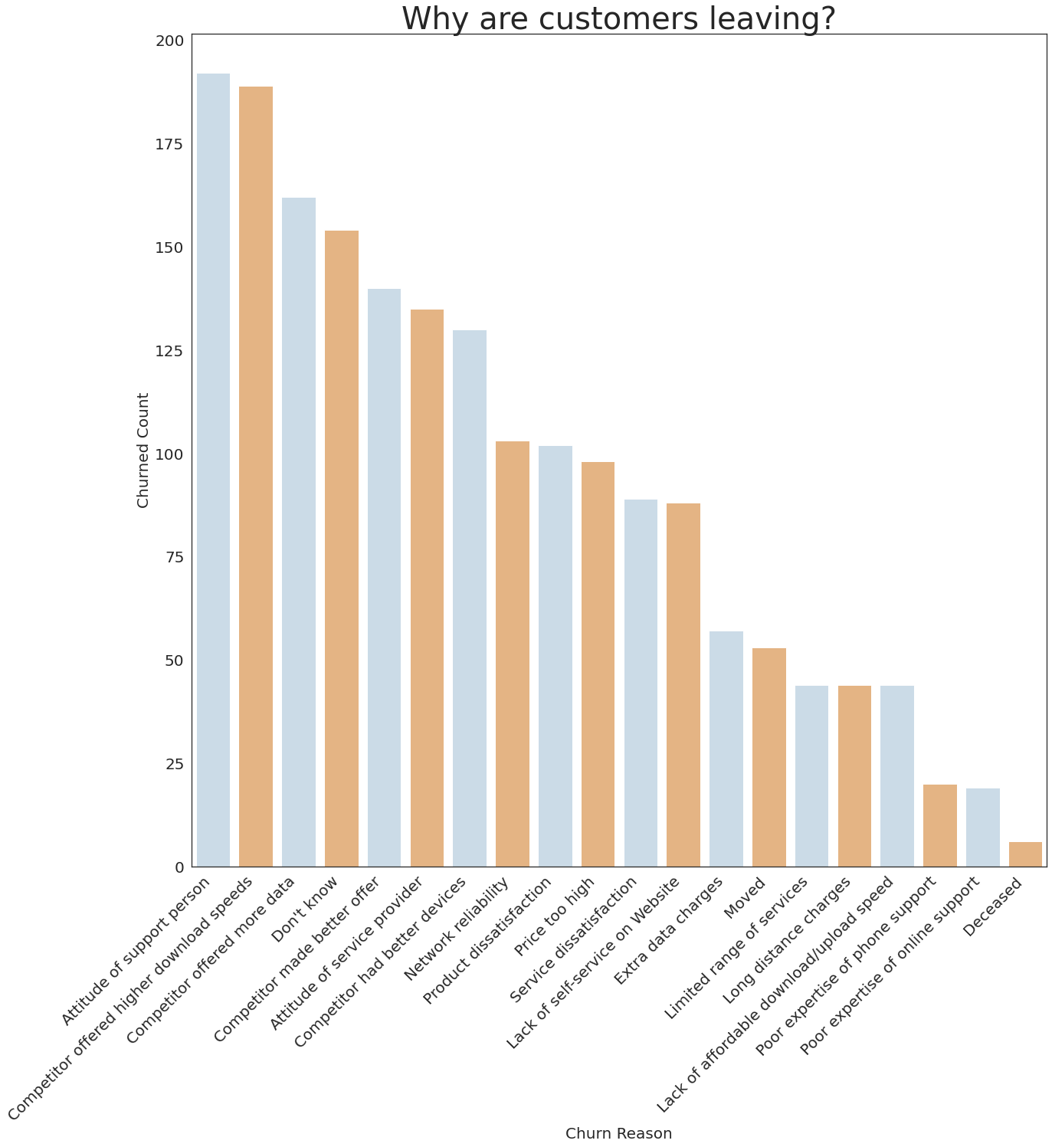
‘Attitude of Support Person’, and ‘Competitor Performance’ are the most influential factors in customers churning.
‘Poor Expertise of Phone/Online Support’ and ‘Deceased’ are the least significant reasons for a customer leaving this service.
Notes:
Although the majority of customers have not given reasons for why they have left, from the data available, it is possible to see that the ‘attitude of support person’, and competitor performance’ are the most influential factors in customers churning. Comparatively, ‘Poor Expertise of Phone/Online Support’ and ‘Deceased’ are the least significant reasons for a customer leaving this service.
It would be wise if this organisation were to focus on customer relations training for the new customer team, as well as implementing loyalty bonuses for customers to potentially decrease the churn rate.

Slide 8
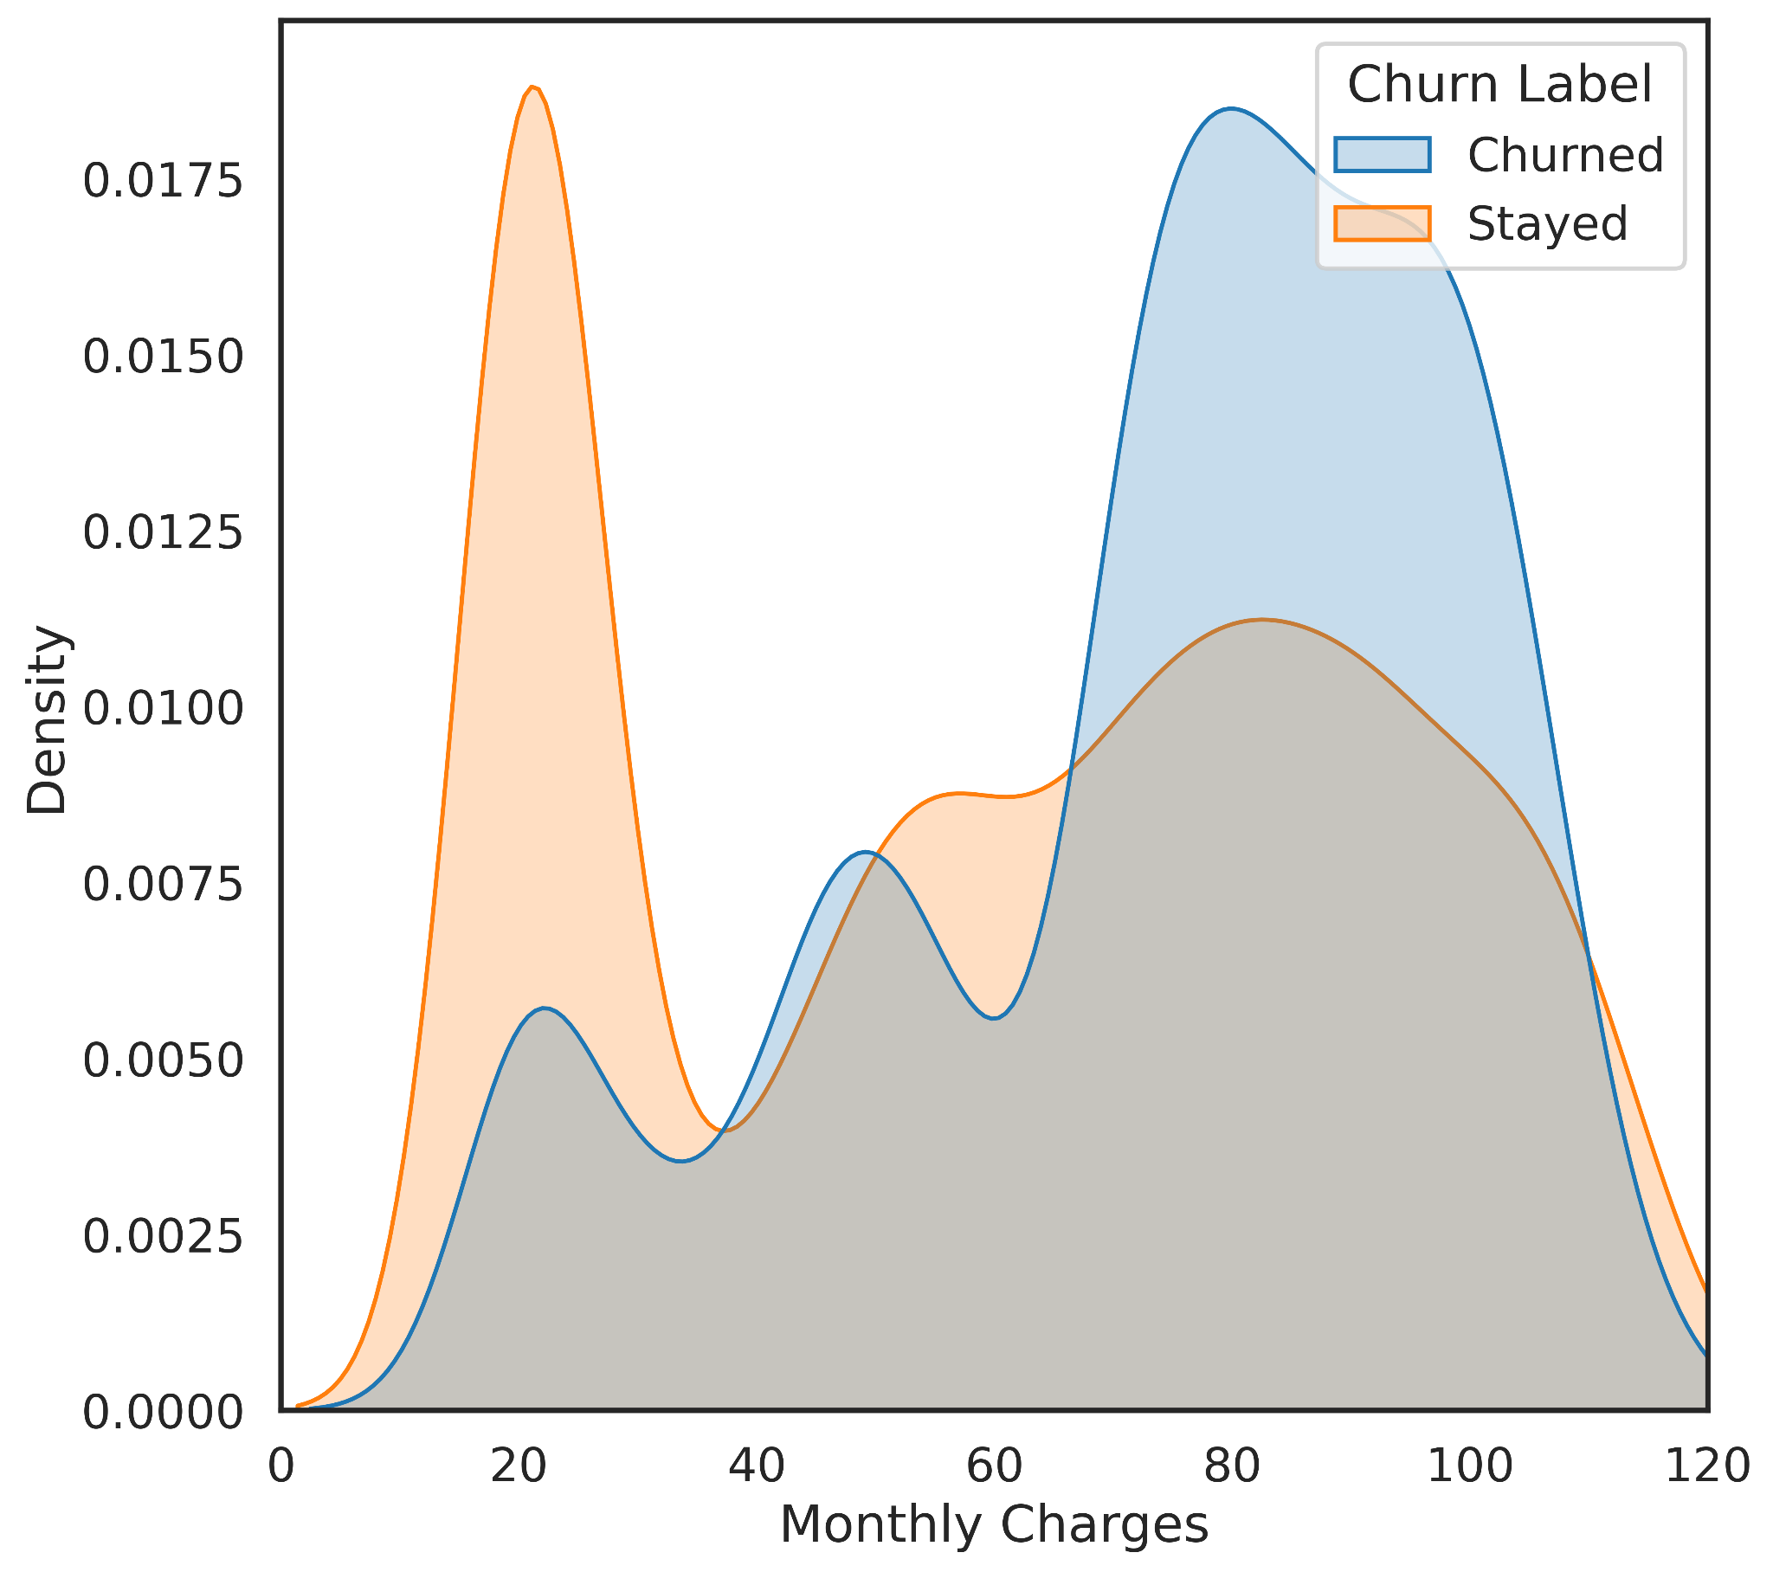
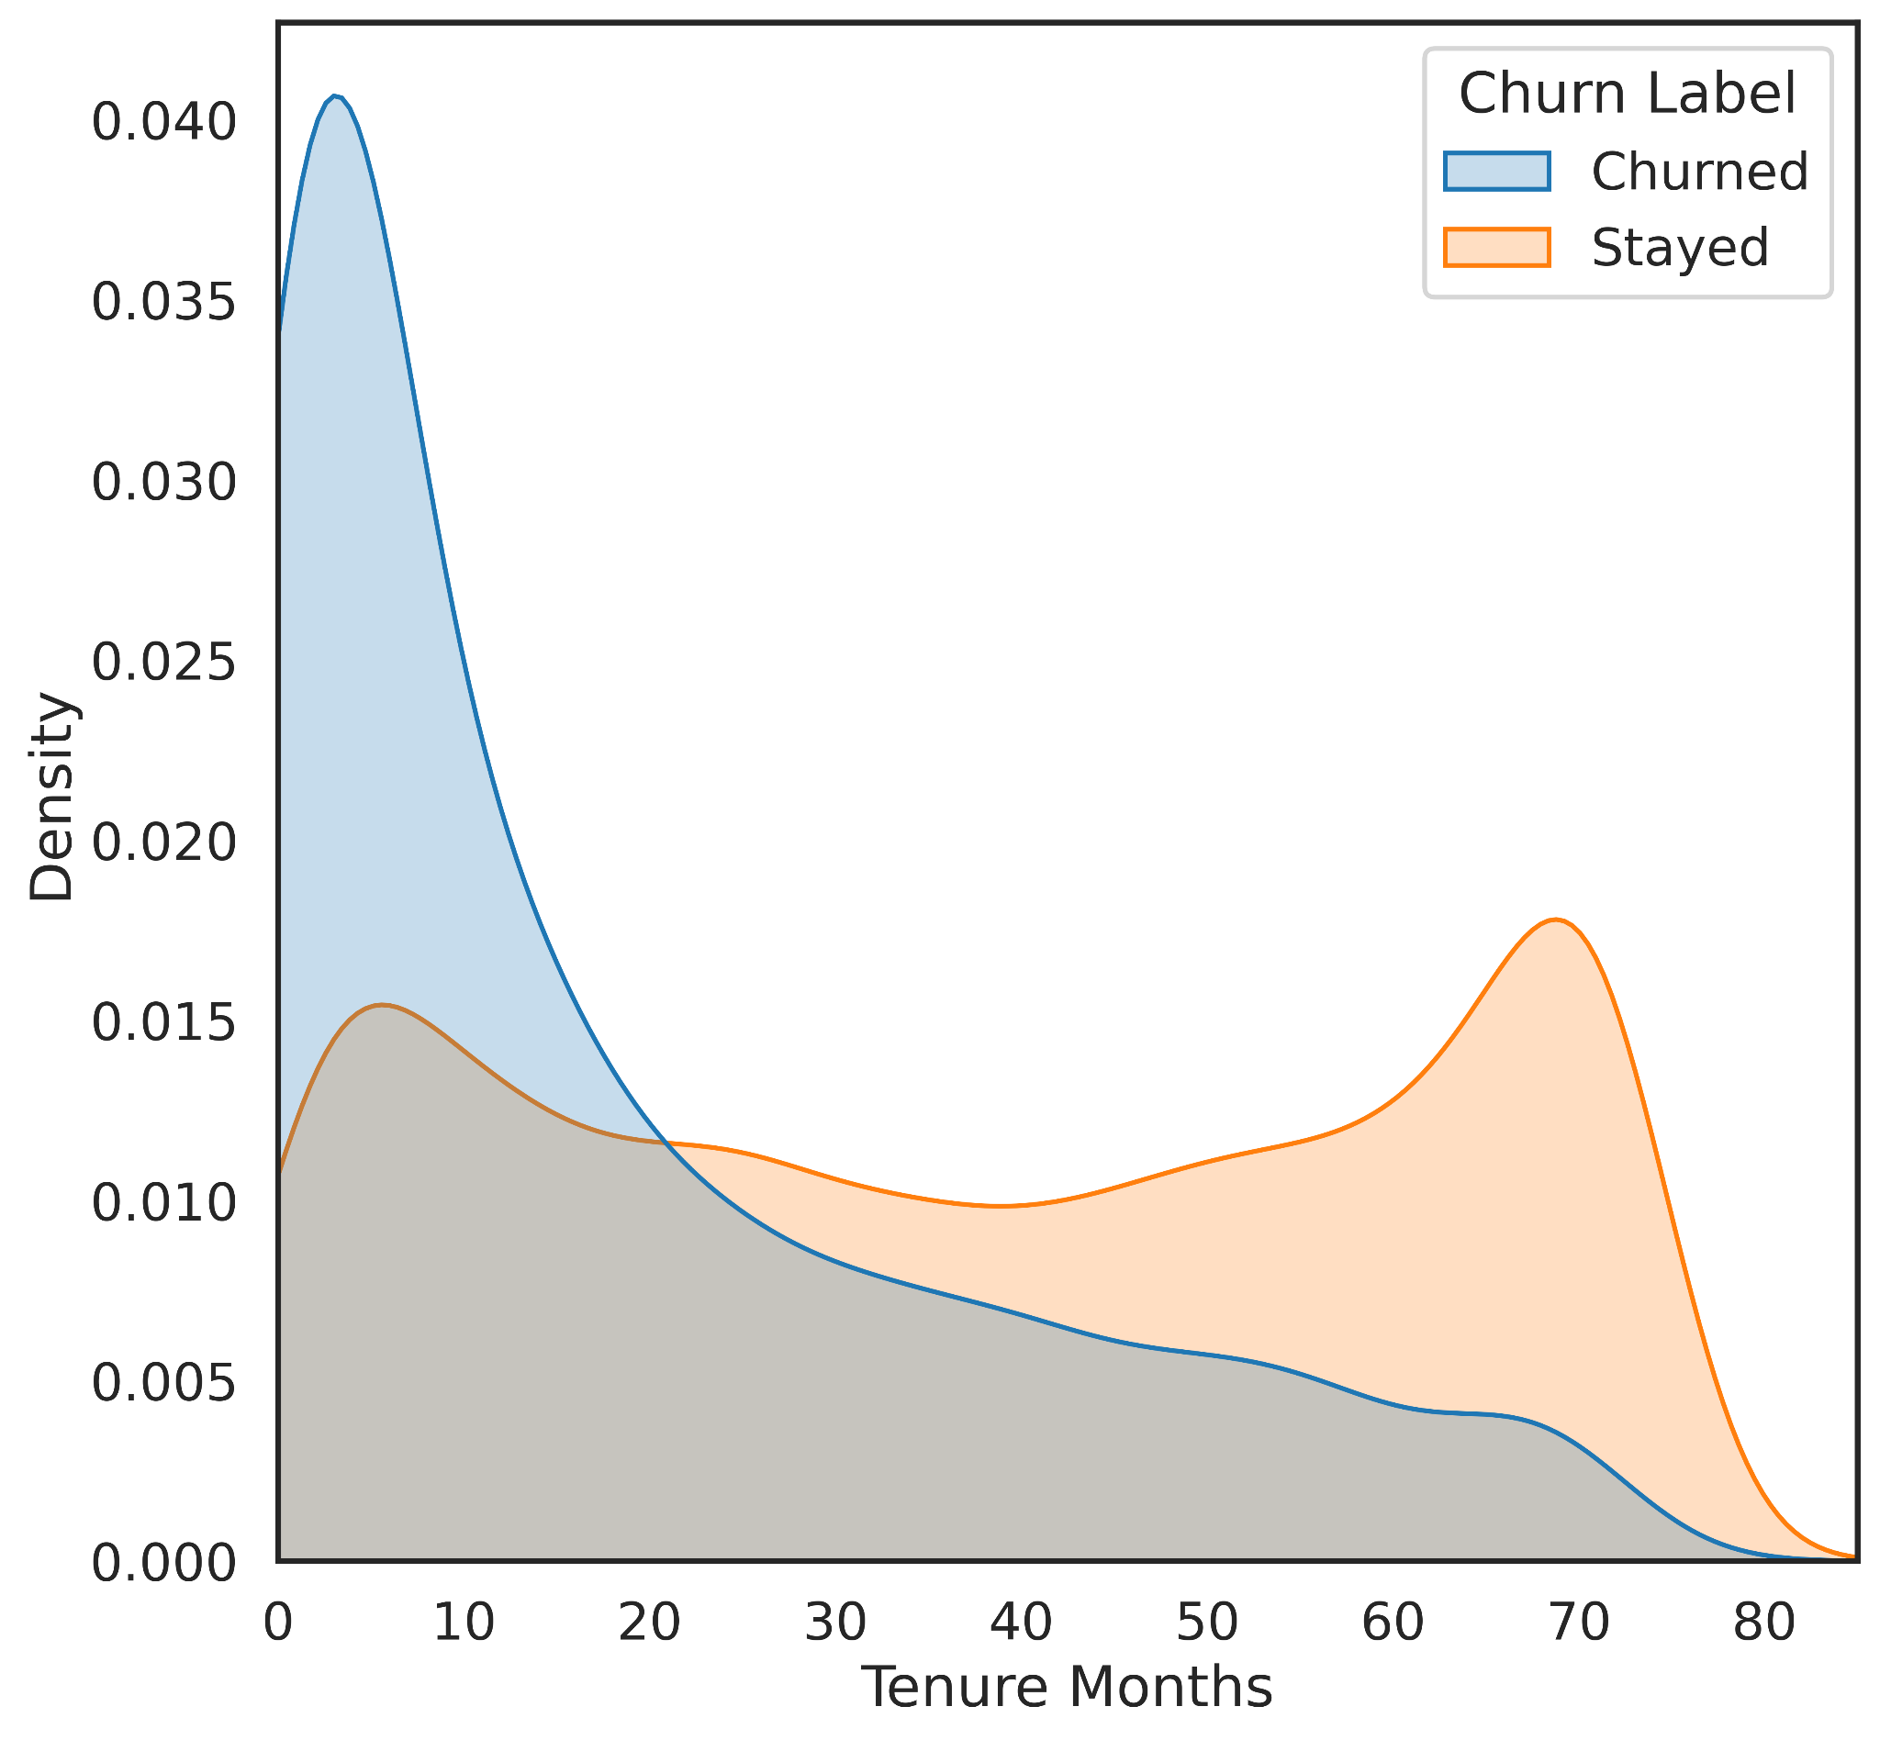
Churned customers usually pay more every month than the customers who Stayed.
Customers who Churned are usually at the beginning of their Tenure.
Notes:
The graph on the left displays churn rates compared to monthly charges, while the right shows churn rates compared to the length of time a customer has or had been subscribed to this company’s services. The data shows that Churned customers usually pay more every month than the customers who Stayed, and Customers who Churned are usually at the beginning of their Tenure. Customers may be leaving at the beginning because of starter discounts that then become too expensive to keep after discounts are removed.

Slide 9
Customer Retention Factors
Notes:
We can now look into factors that help this business retain customers.

Slide 10
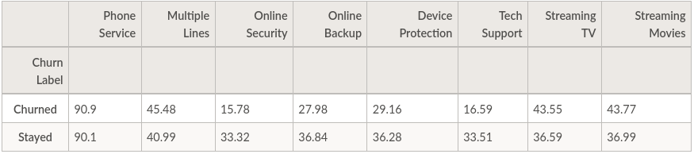
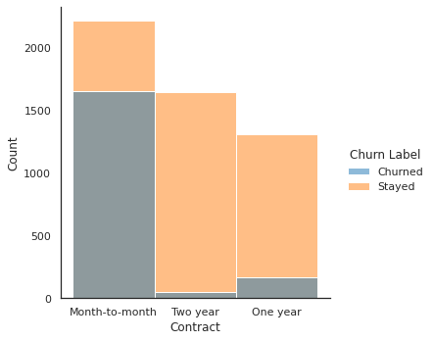
37 percent of those who stayed have Streaming Movies and Streaming TV packages.
44 percent of those who had churned had these packages.
Those who churned were less likely to have the ‘Online Security’ and ‘Tech Support’ packages than those who stayed.
Customers who are on a month-to-month contract are much more likely to churn.
Notes:
We can see from the table that those who churned were less likely to have the ‘Online Security’ and ‘Tech Support’ packages than those who stayed. These are the packages the company should be pushing to customers.
37 percent of those who stayed have Streaming Movies and Streaming TV packages. On the other hand 44 percent of those who had churned had these packages. This difference tells us that there might be a problem with the Streaming packages. Either they are not as good, or perhaps they are too expensive for customers.
Customers who are on a month-to-month contract are much more likely to churn. Discounts for users to change to a one year or two year contract would result in less people churning.

Slide 11
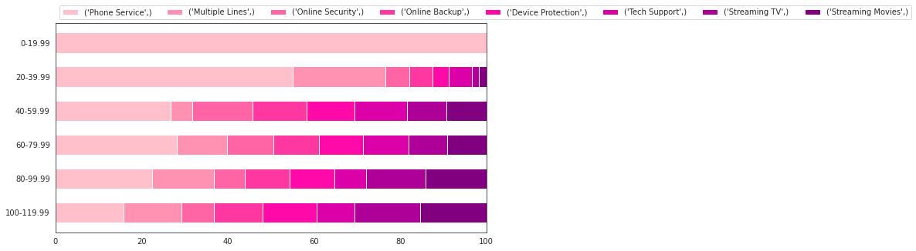
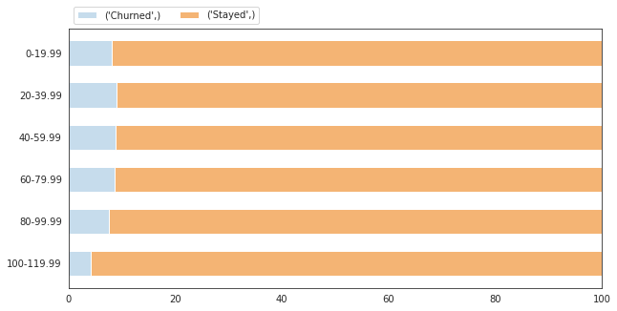
A customer paying a monthly fee of less than $20 will be paying for phone service, while spending over $40 will be provided all available services.
Customers who are paying in the middle range, $20 to $80, are more likely to churn than customers who either pay low monthly fees of under $20 or high monthly fees of over $80.
Notes:
The top graph shows how the monthly cost affects what services are provided, while the bottom graph shows the rate a customer churns in accordance to monthly cost.
A customer paying a monthly fee of less than $20 will be paying for phone service, while spending over $40 will be provided all available services. It can be seen that higher monthly costs result in a larger proportion in the use of streaming services.
The bottom graph indicates that generally, customers who are paying in the middle range, $20 to $80, are more likely to churn than customers who either pay low monthly fees of under $20 or high monthly fees of over $80. This may indicate that customers are generally more satisfied with phone and streaming services than other services.

Slide 12
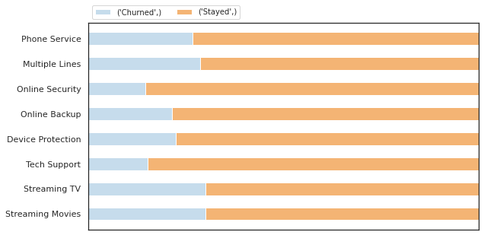
Retention Incentive
Customers that are staying are utilising more of the services provided.
Customers that have churned are more likely to sign up for streaming services, while not using Security and Backup Services.
Online Security and Tech Support seem to be the least used services by churned customers, and more by customers who stay.
Notes:
Looking at the distribution of services across all customers, it is clear that customers that are staying are utilising more of the services provided, especially making use of security and backup services.
Customers that have churned are more likely to sign up for streaming services, while not using security and backup services, therefore it would be advisable to push for customers to sign up for online security, backup, device protection and tech support at a fair price.
A specific focus could be given to the customer team to push for retention for existing customers, and for new customers to sign-up for online security and tech support, as these seem to be the least used services by churned customers, and more by customers who stay.

